Slide 1
Si samples 9 march 2010
From Chiara march 2010
R6-Q3-210
Electronic grade, Polysilicon, feedstock from Siemens process
Four pieces: A, B, C, D
ES1-Q3-201
Solar grade, added P and B,
Four pieces: A, B, C, D
MH2-Q3-210
Solar grade, added P, B and Cr
Four pieces: A, B, B2, C

Slide 2
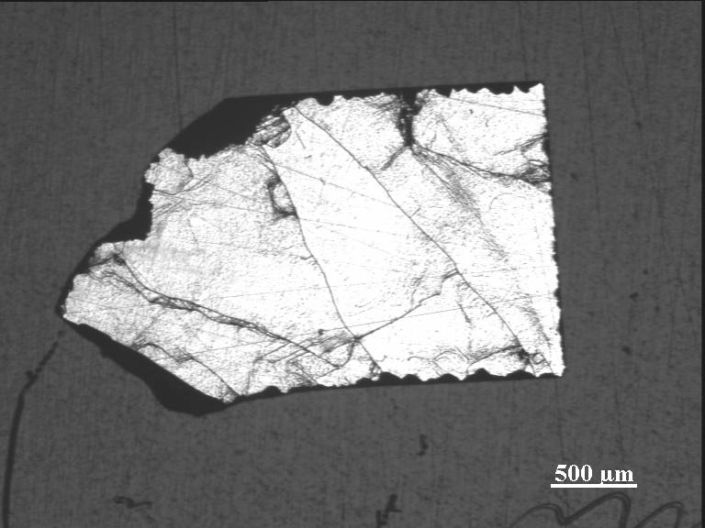
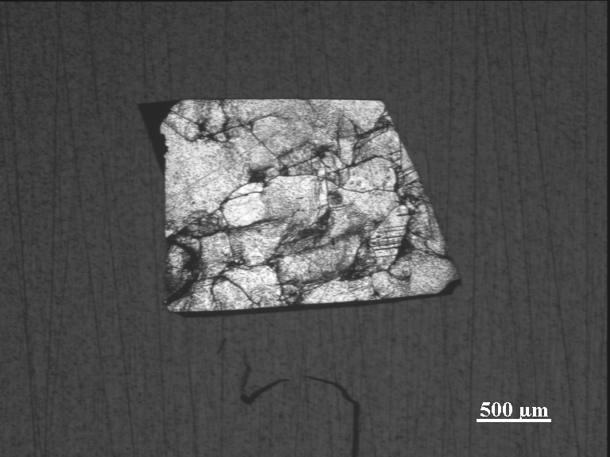
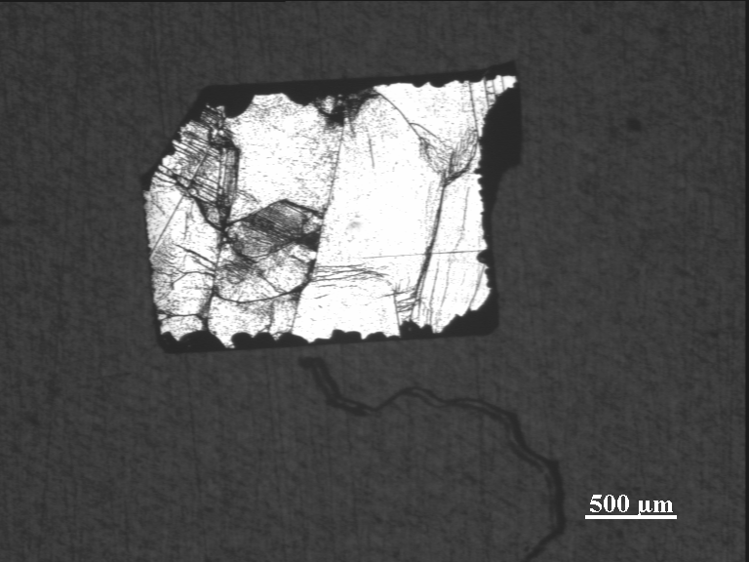
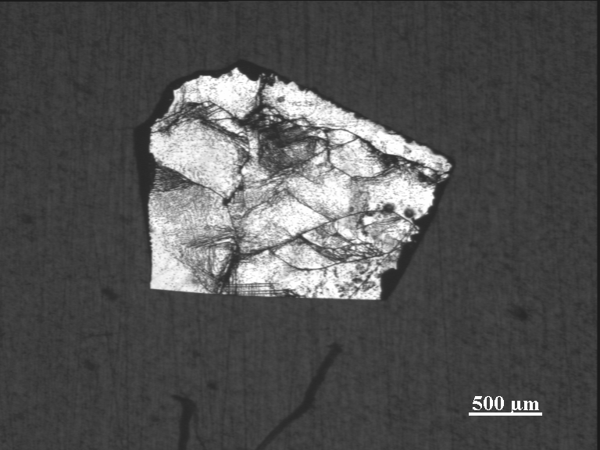
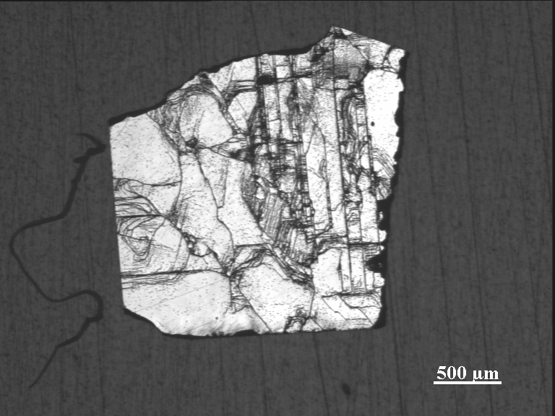
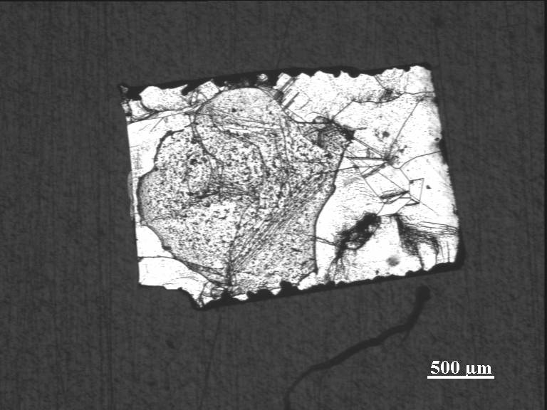
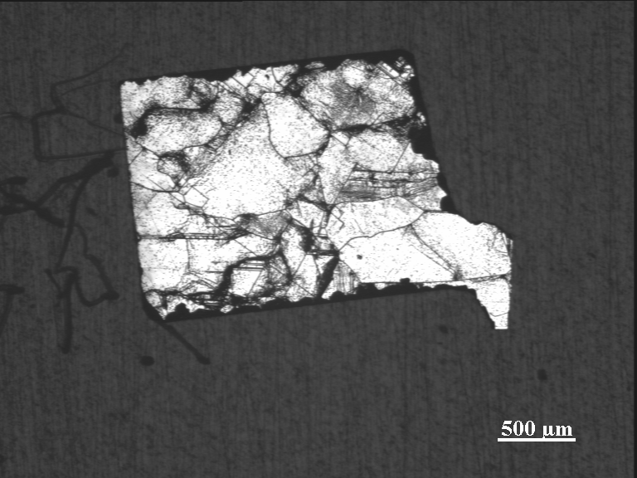
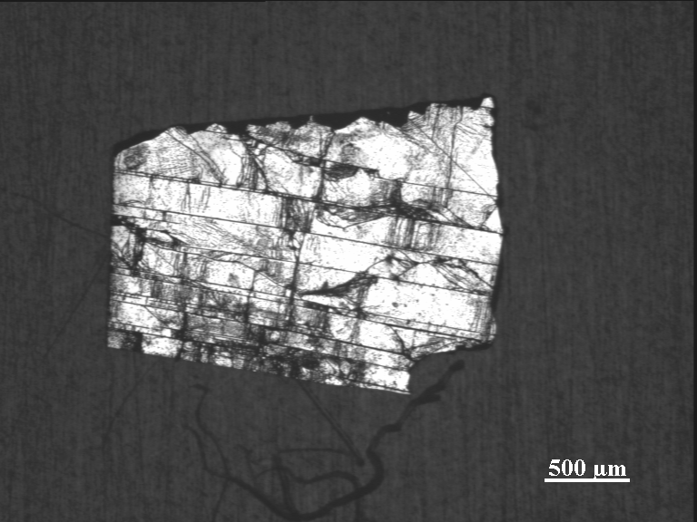
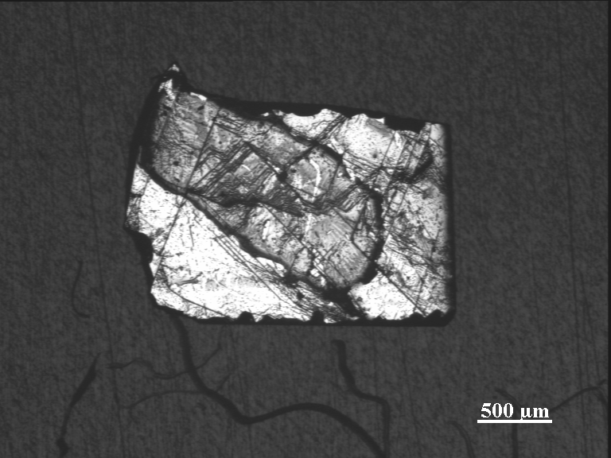
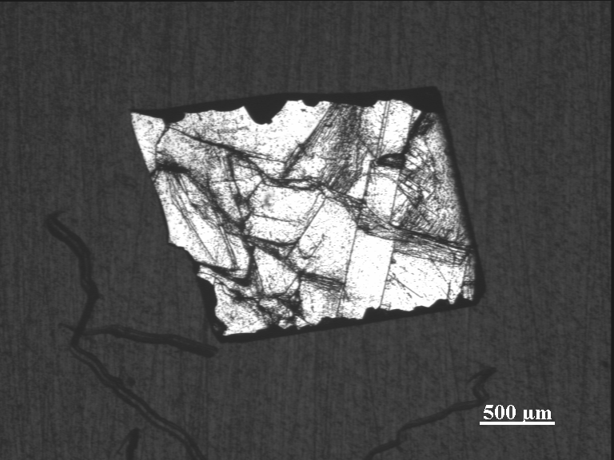
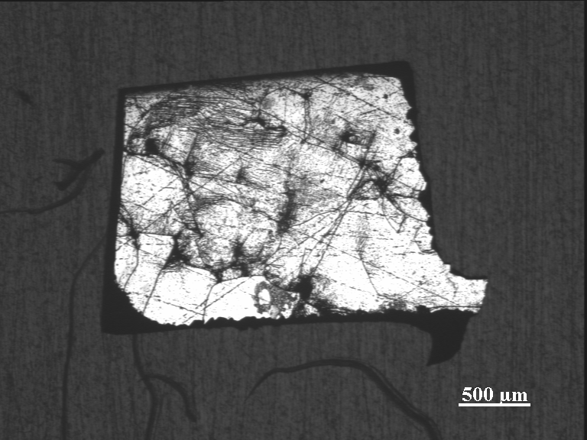
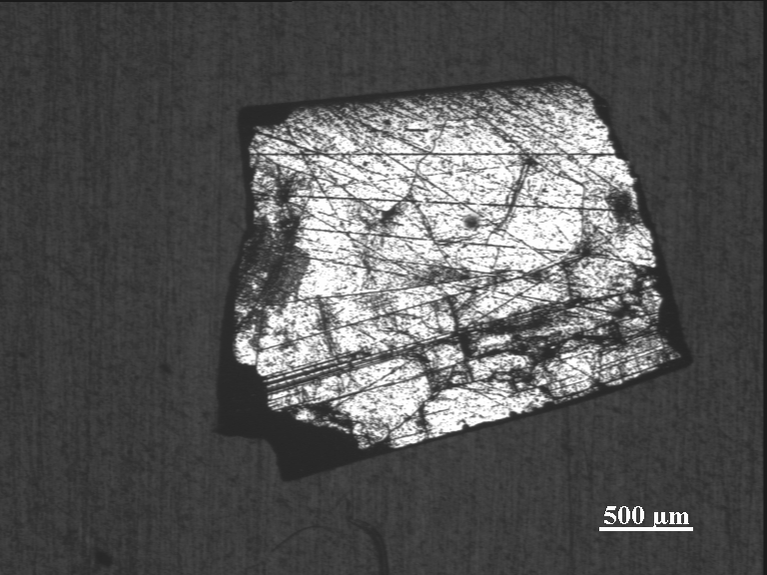
Si samples 9 march 2010
ES1-Q3-201 A B C D
R6-Q3-210 A B C D
MH2-Q3-210 A B B2 D

Slide 3
R6-Q3-210
A B

Slide 4
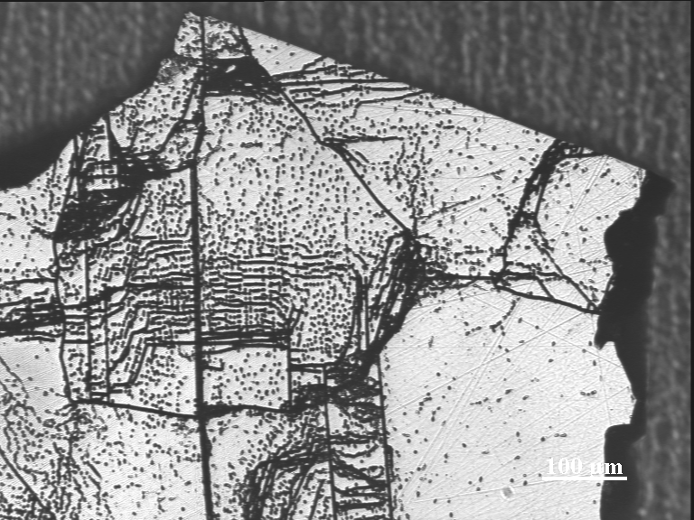
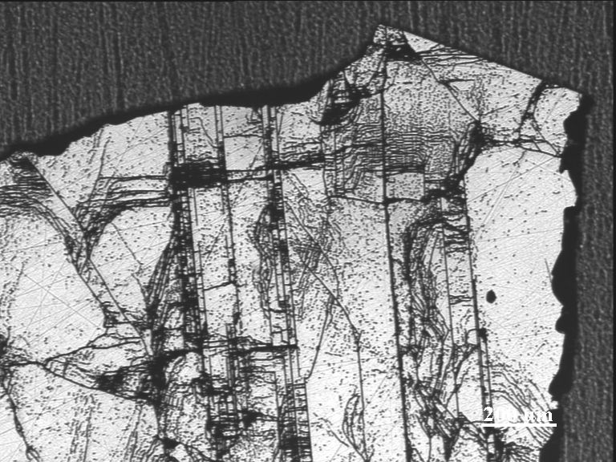
R6-Q3-210 A

Slide 5
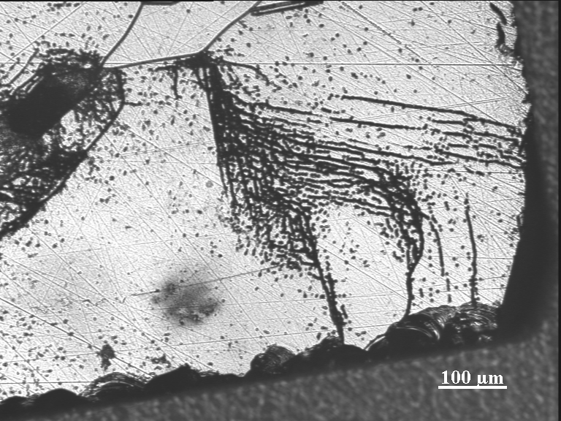
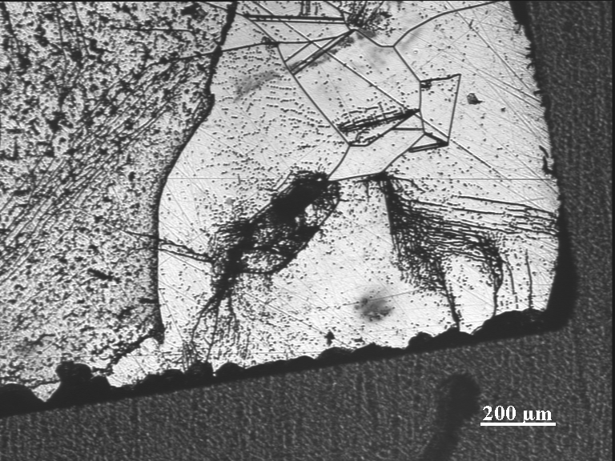
R6-Q3-210 B

Slide 6
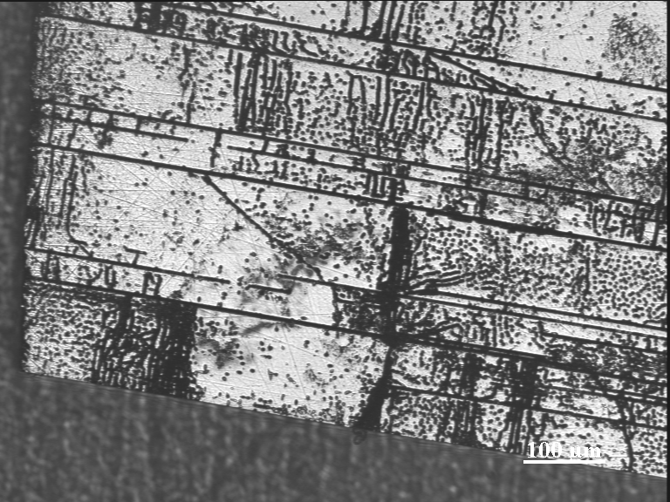
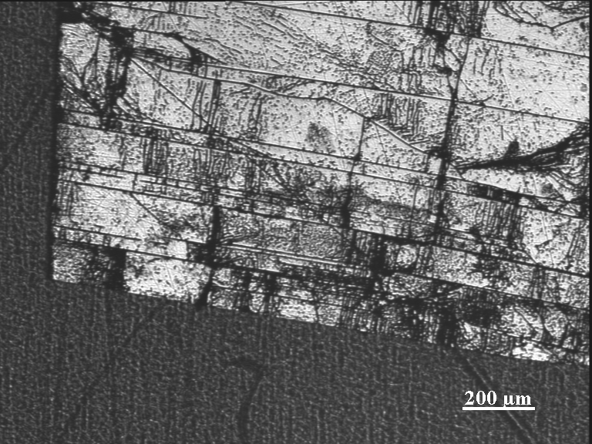
R6-Q3-210 D

Slide 7
ES1-Q3-201

Slide 8
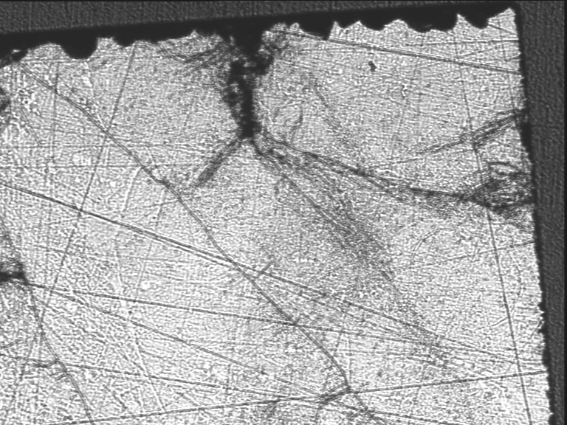
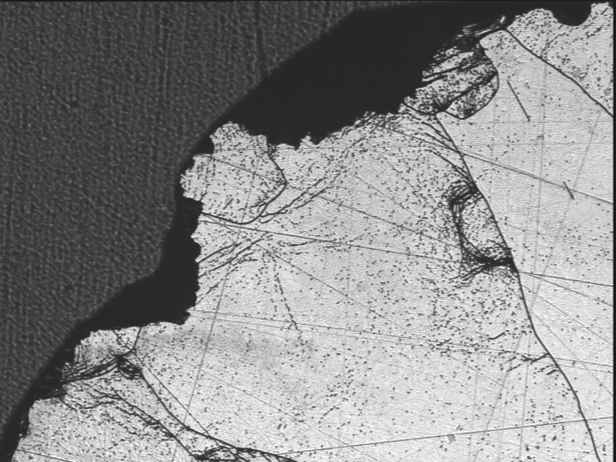
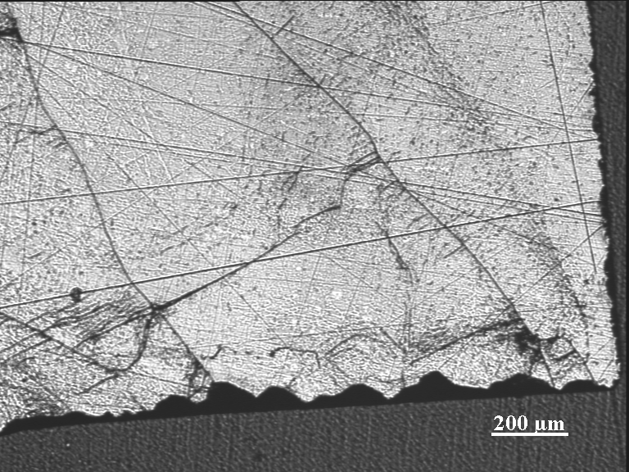
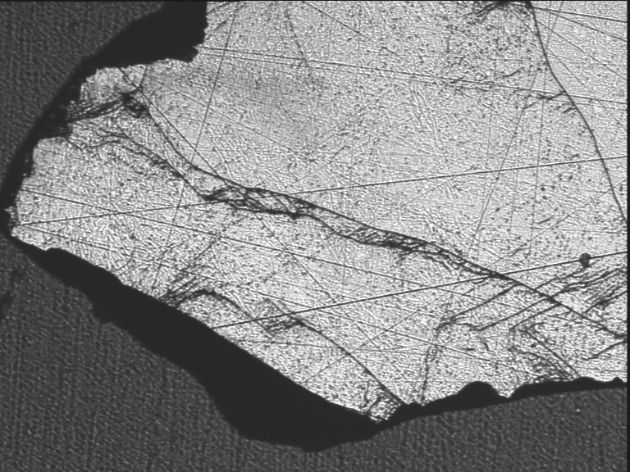
ES1-Q3-201 A

Slide 9
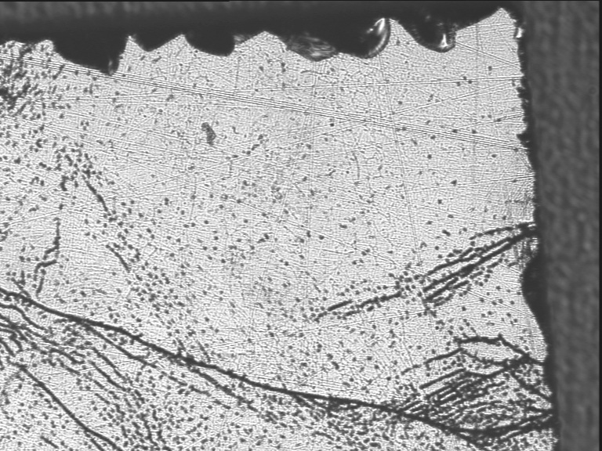
ES1-Q3-201 A

Slide 10
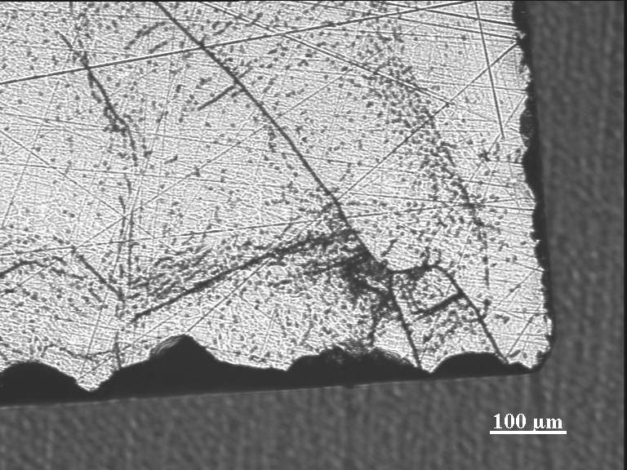
ES1-Q3-201 A

Slide 11
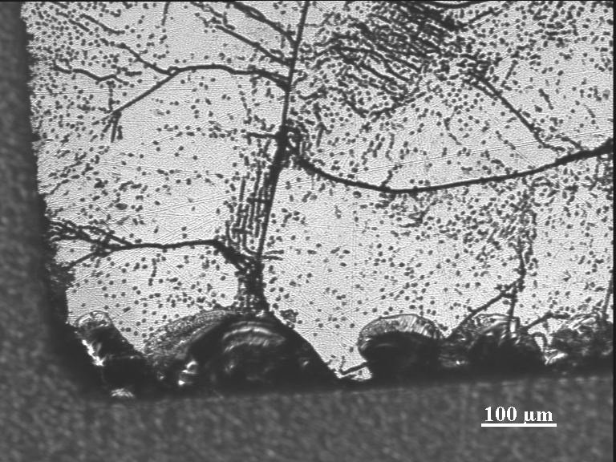
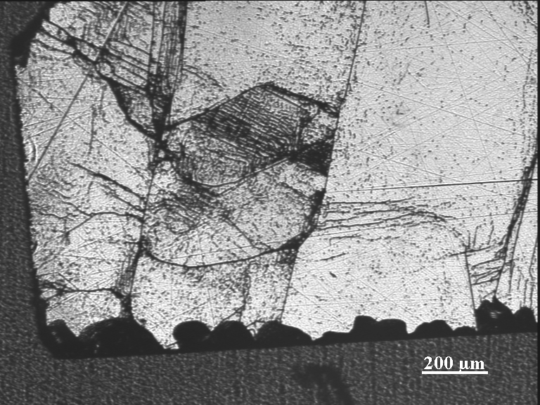
ES1-Q3-201 C

Slide 12
MH2-Q3-210

Slide 13
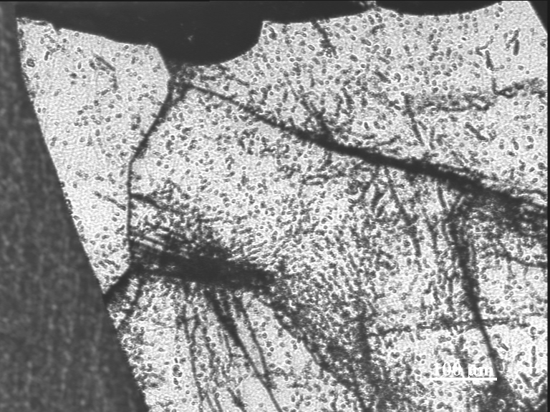
MH2-Q3-210 B

Slide 14
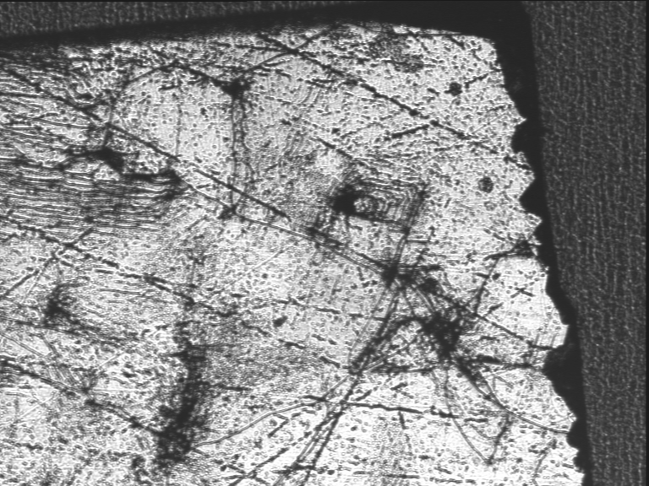
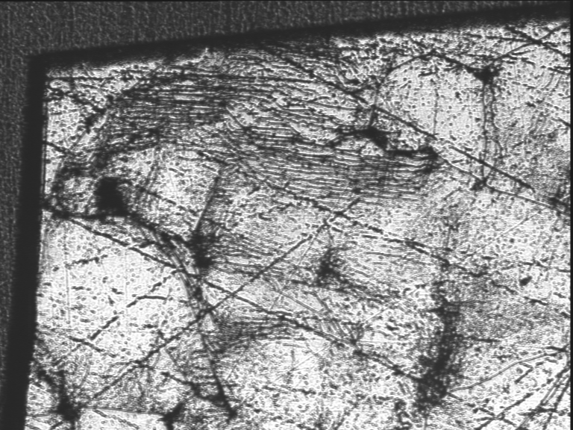
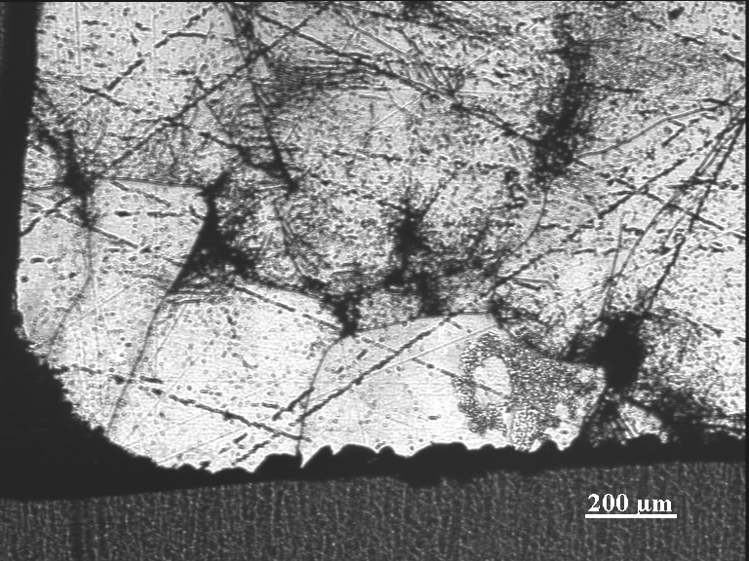
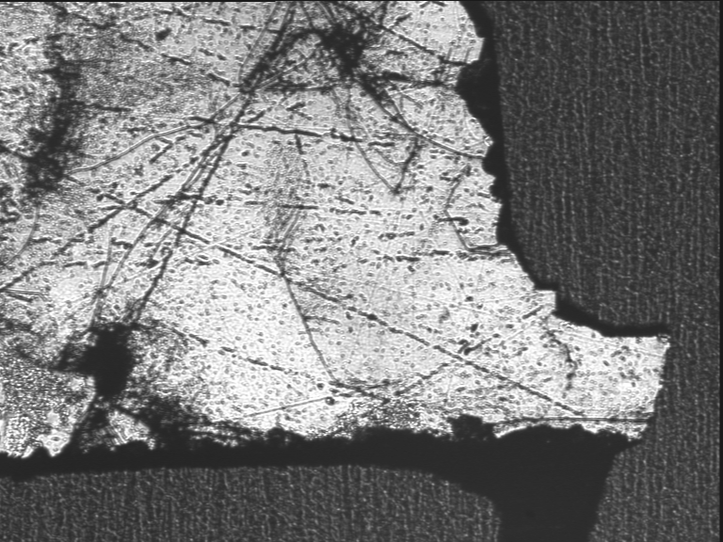
MH2-Q3-210 B2

Slide 15
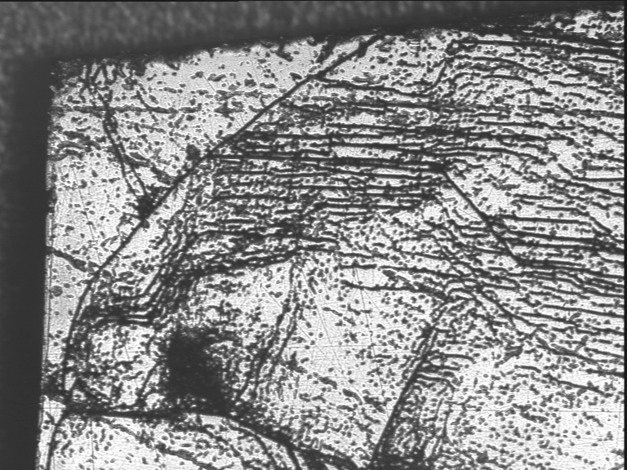
MH2-Q3-210 B2

Slide 16
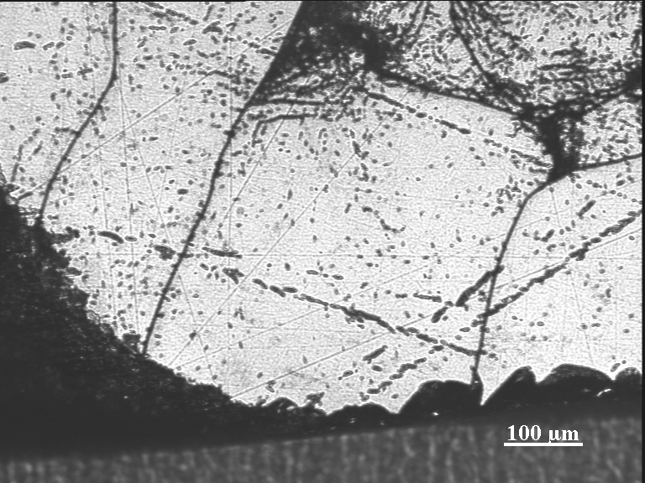
MH2-Q3-210 B2

Slide 17
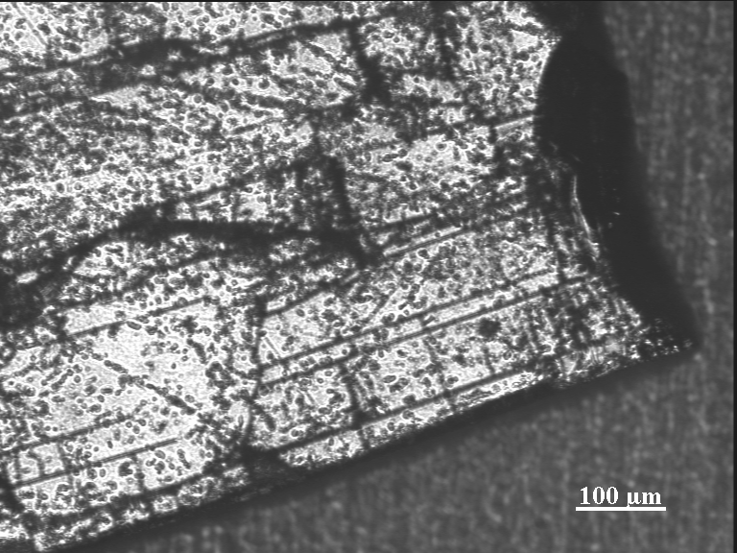
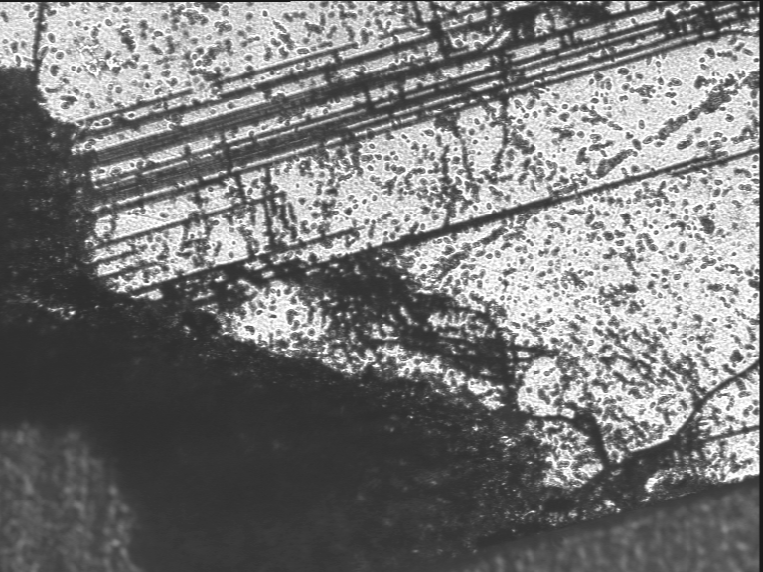
MH2-Q3-210 C

Slide 19
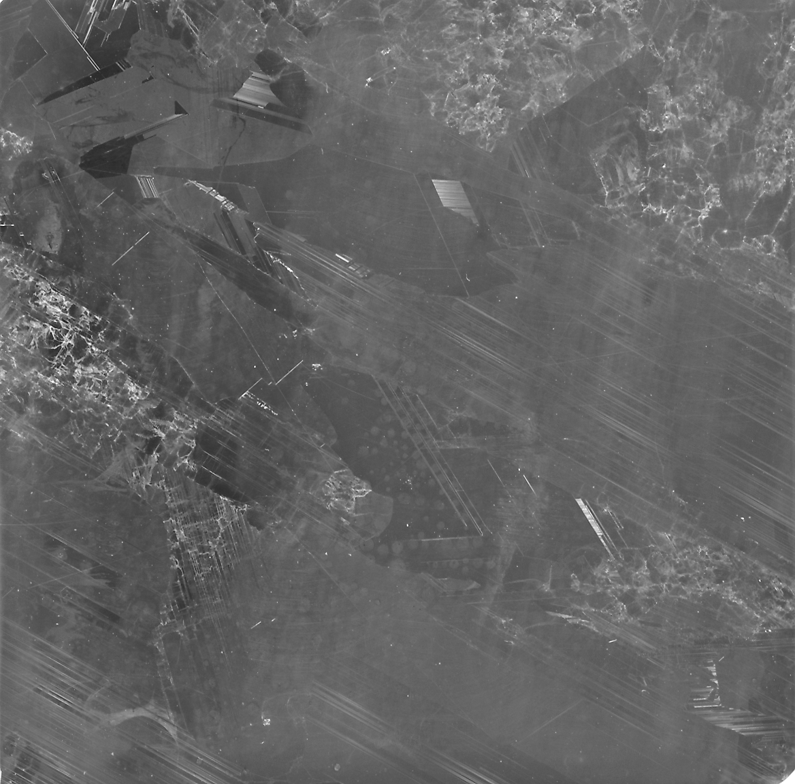
Spot | Distance from left (mm) | Distance from top (mm)
A | 30 | 0
B | 34 | 0
C | 47 | 3
D | 37 | 0
ES1-Q3-201
A
B
D
C
DISTANCES REFERRED TO THE TOP LEFT CORNER OF THE PIECE GIVEN THE ORIENTATION OF THE PICTURE

Slide 20
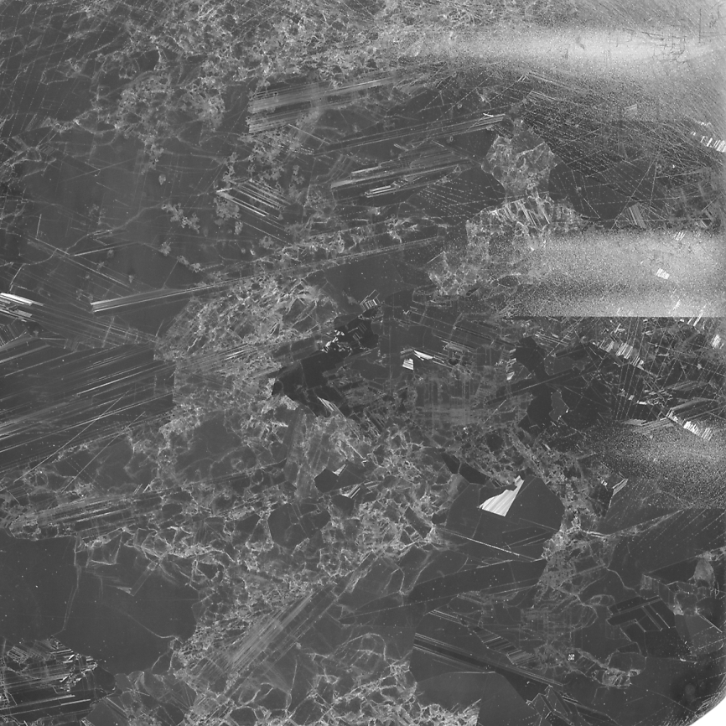
Spot | Distance from left (mm) | Distance from top (mm)
A | 10 | 0
B | 14 | 0
B2 | 20 | 0
C | 27 | 0
MH2-Q3-210
A
B
B2
C
DISTANCES REFERRED TO THE TOP LEFT CORNER OF THE PIECE GIVEN THE ORIENTATION OF THE PICTURE

Slide 21
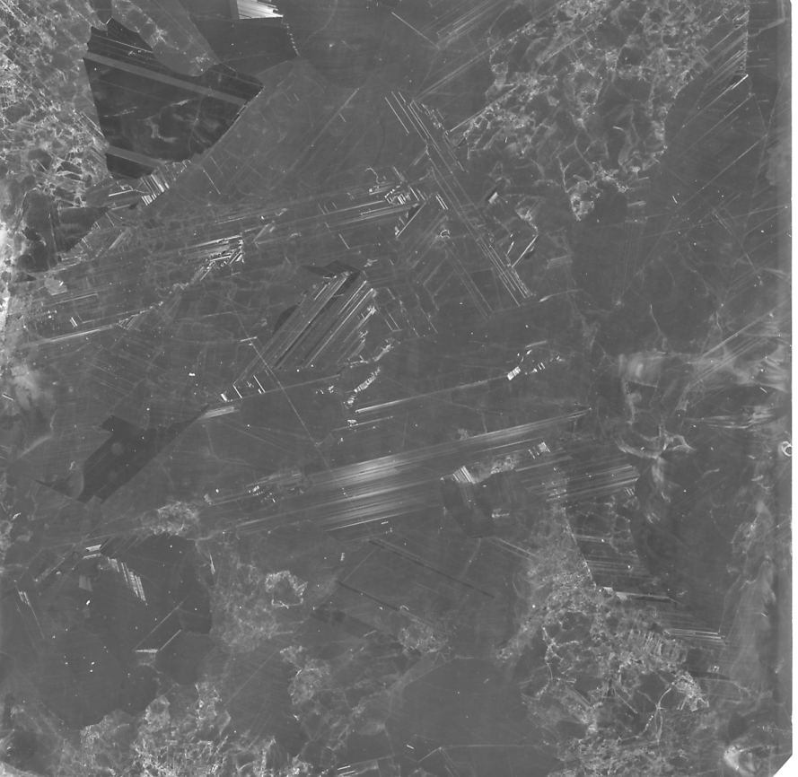
R6-Q3-210
Spot | Distance from left (mm) | Distance from top (mm)
A | 4 | 47
B | 7 | 47
C | 10 | 47
D | 13 | 47
DISTANCES REFERRED TO THE TOP LEFT CORNER OF THE PIECE GIVEN THE ORIENTATION OF THE PICTURE
A
B
C
D

